Slide 1
geophysics in a changing climate
Lindsey Heagy
UBC Geophysical Inversion Facility
BCGS Breakfast Feb 1, 2022

Slide 2
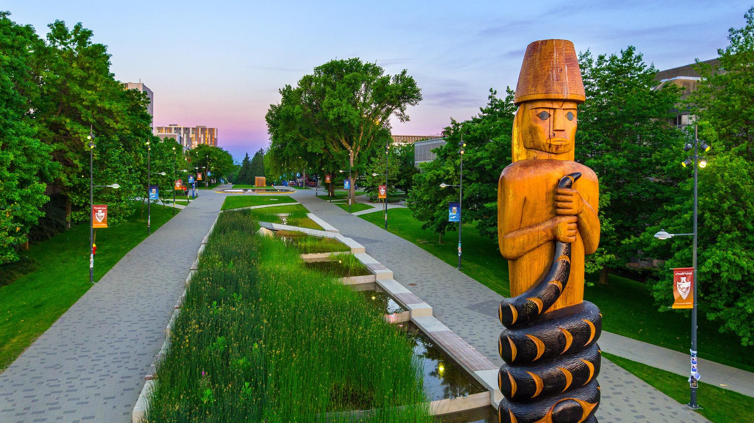
UBC Vancouver is located on the traditional, ancestral, and unceded territory of the xʷməθkʷəy̓əm people
Hover Collective / UBC Brand & Marketing
Notes:
climate change, resources and our relationship to land
role in society and changing social landscape

Slide 3
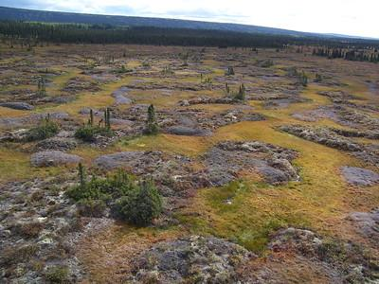
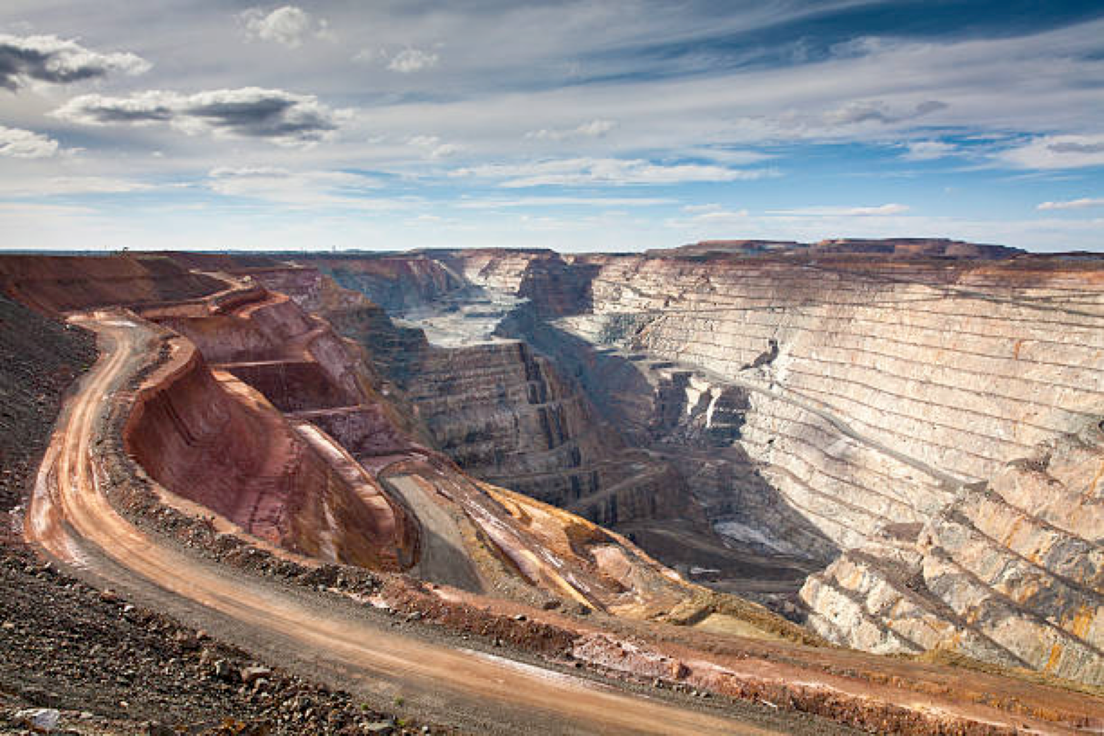
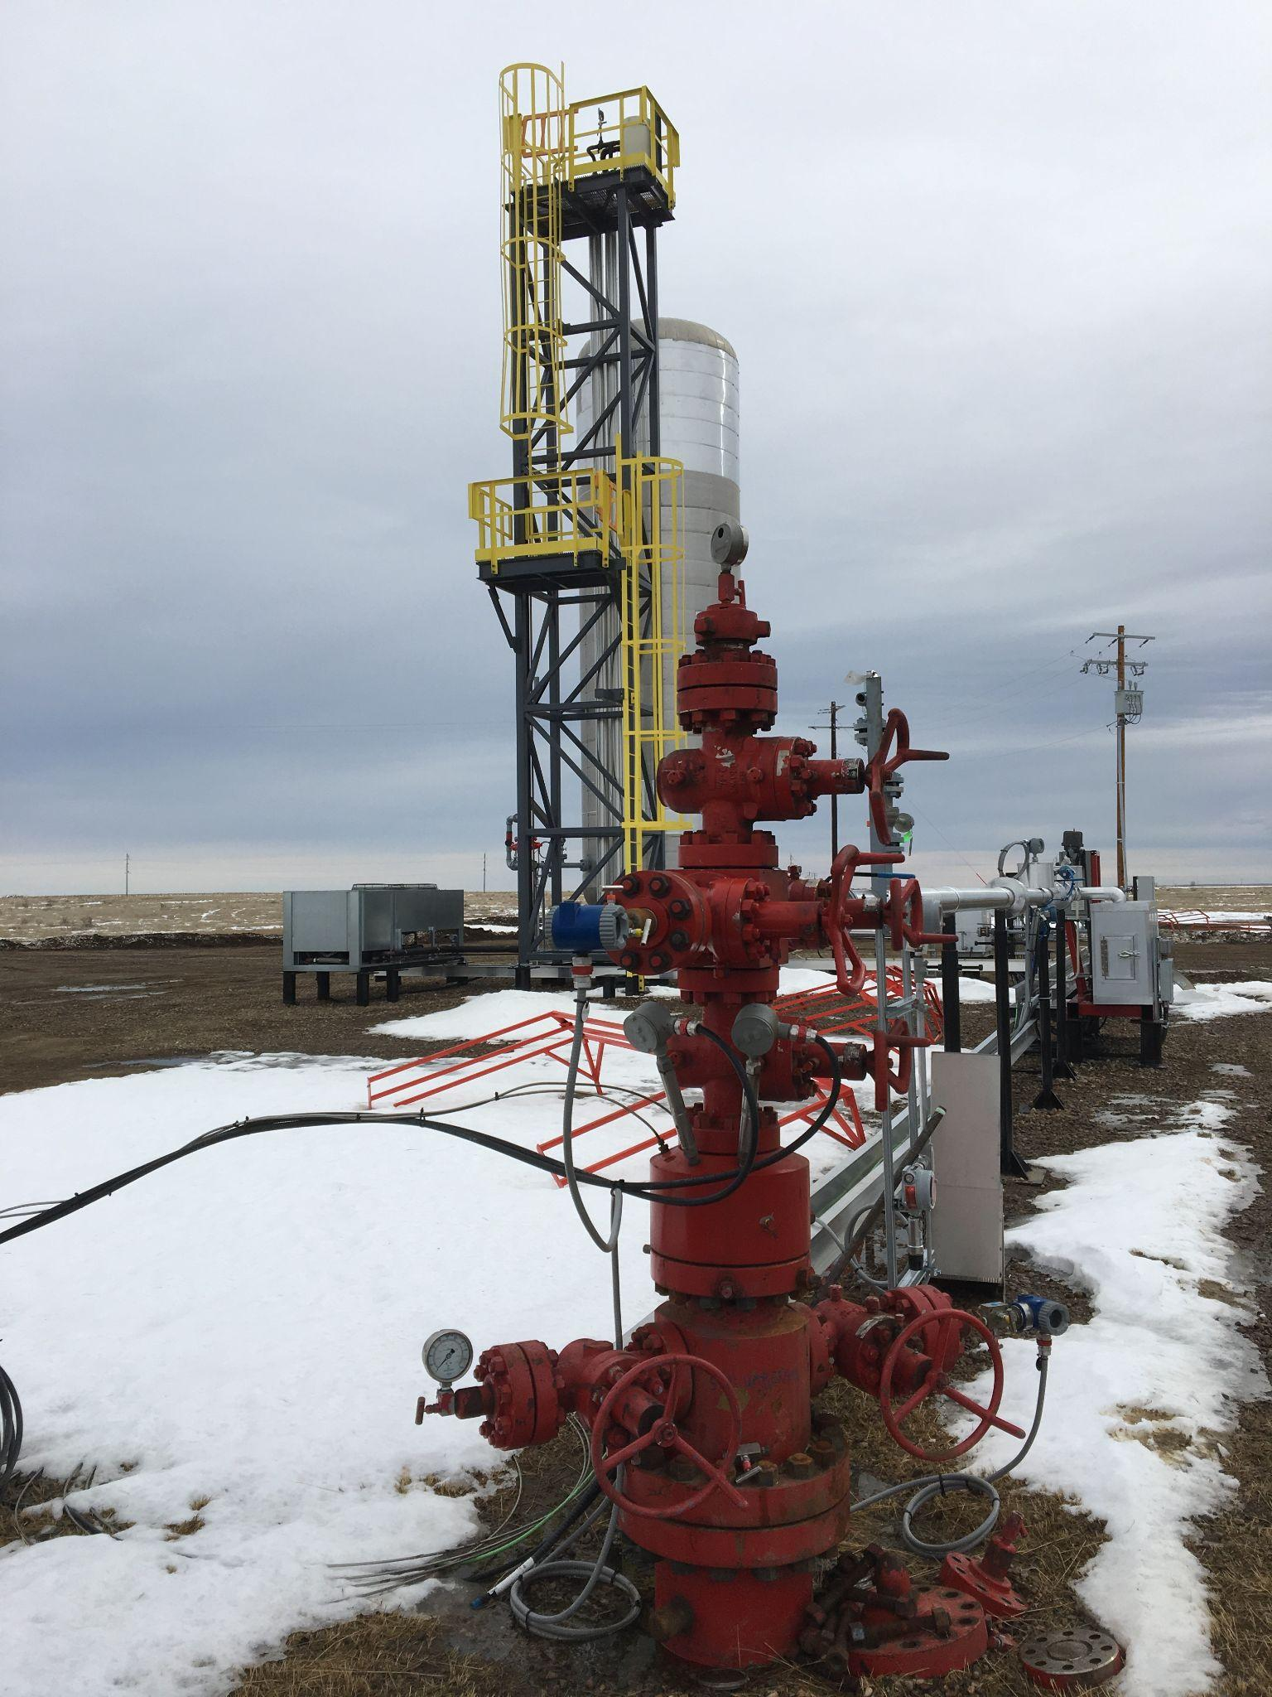
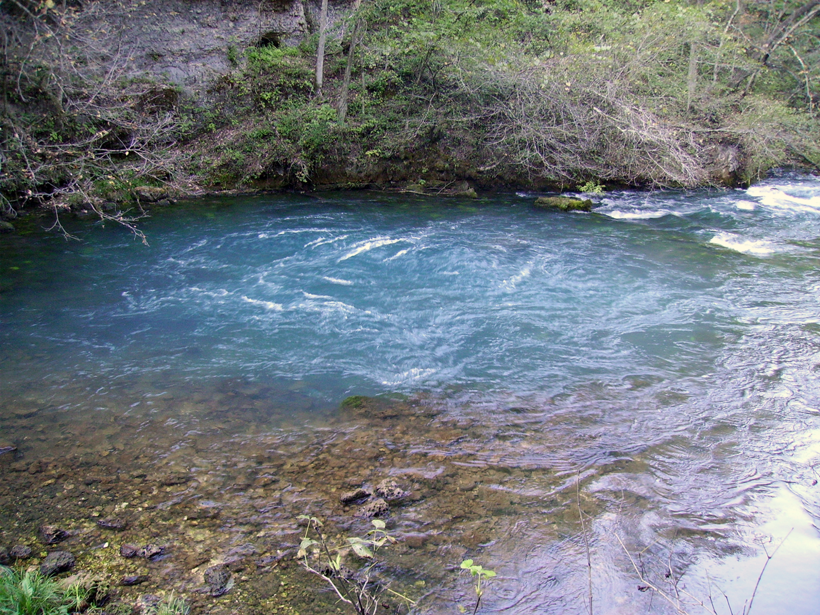
climate crisis
solutions & mitigating impacts: opportunities for geophysics
geotechnical (e.g. permafrost)
critical minerals
geologic storage of CO₂
groundwater
Notes:
some aspects that intersect with geophysics (obviously many more!)
moving off of hydrocarbons requires minerals for batteries, solar panels, maintenance of quality of life
1.5C likely to occur, even in best case scenario (IPCC), need carbon removal technologies to be a part of the solution
impacts: changing landscapes, permafrost of particular importance in Canada’s north
groundwater prevalent worldwide: developing nations, as well as agriculture-heavy (e.g. California)

Slide 4
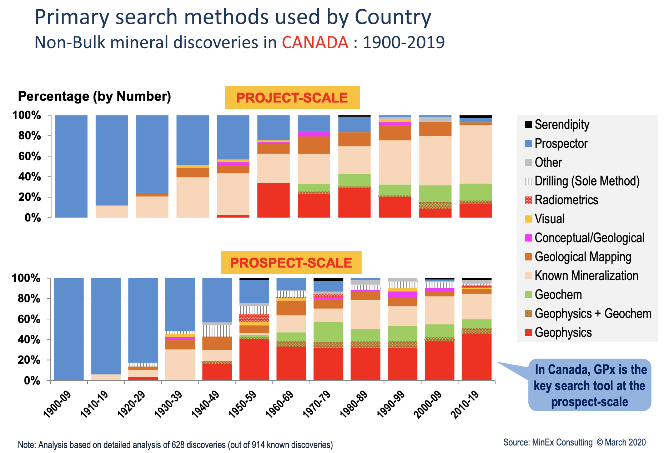
critical minerals
connecting geologic questions to geophysics
depth: imaging under cover
Alan Jones talk: youtube.com/watch?v=T2mZpV6-8-o
Schodde, 2020
Notes:
globally, GP ~10% of project scale, ~22% prospect scale

Slide 5
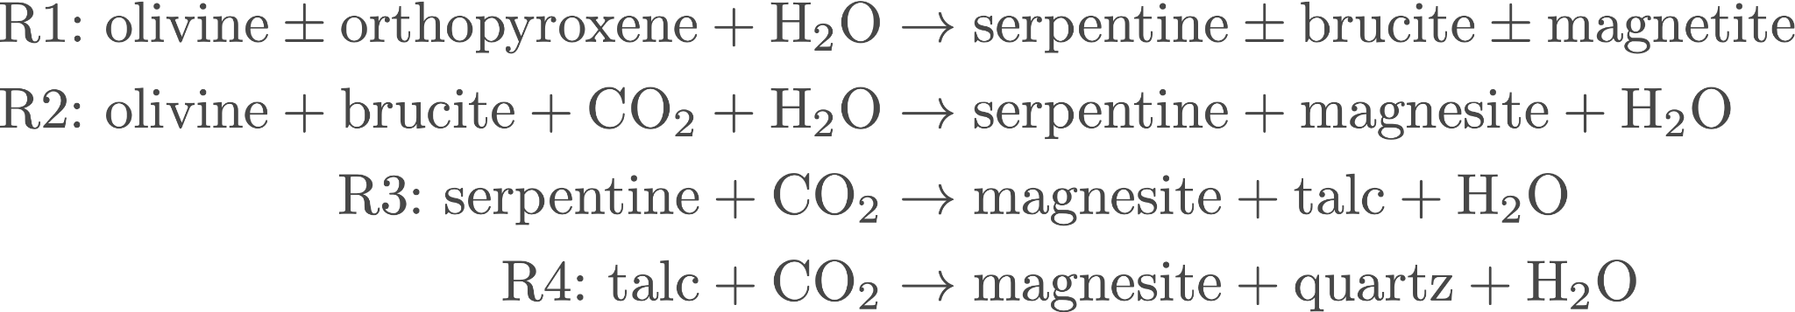
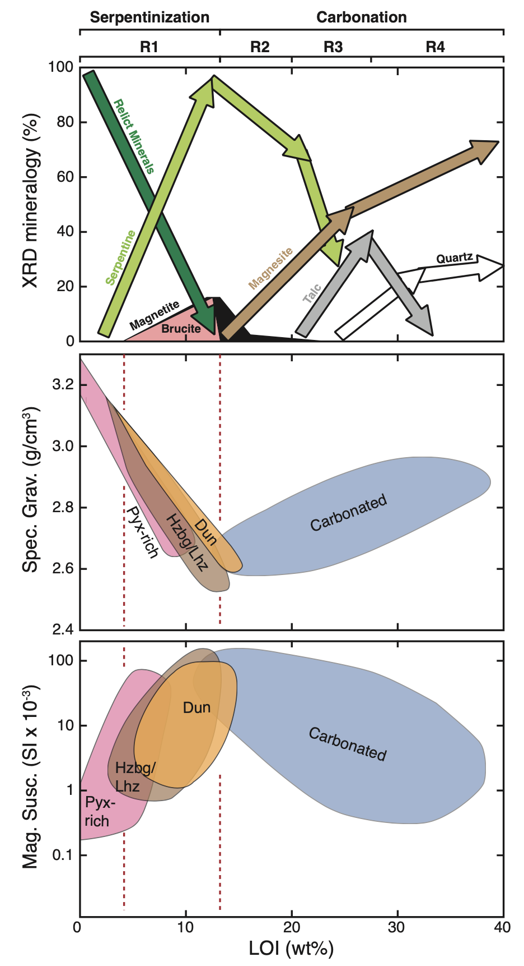
geologic storage of CO₂
sedimentary: depleted reservoirs, saline aquifers
carbon mineralization: CO₂ reacts with mafic or ultramafic rocks to form carbonated minerals
Cutts et al., 2021; Mitchinson et al., 2020

Slide 6
managing impacts: permafrost, groundwater…
permafrost
opportunities for AEM to cover large areas
IP from AEM?
groundwater
monitoring
developing groundwater models, connecting with flow modelling
low-cost methods, education in emerging countries

Slide 7
research opportunities: advancing methods in geophysics
questions in electromagnetics
integrating geology, physical properties, and geophysics
joint inversions
role of machine learning

Slide 8
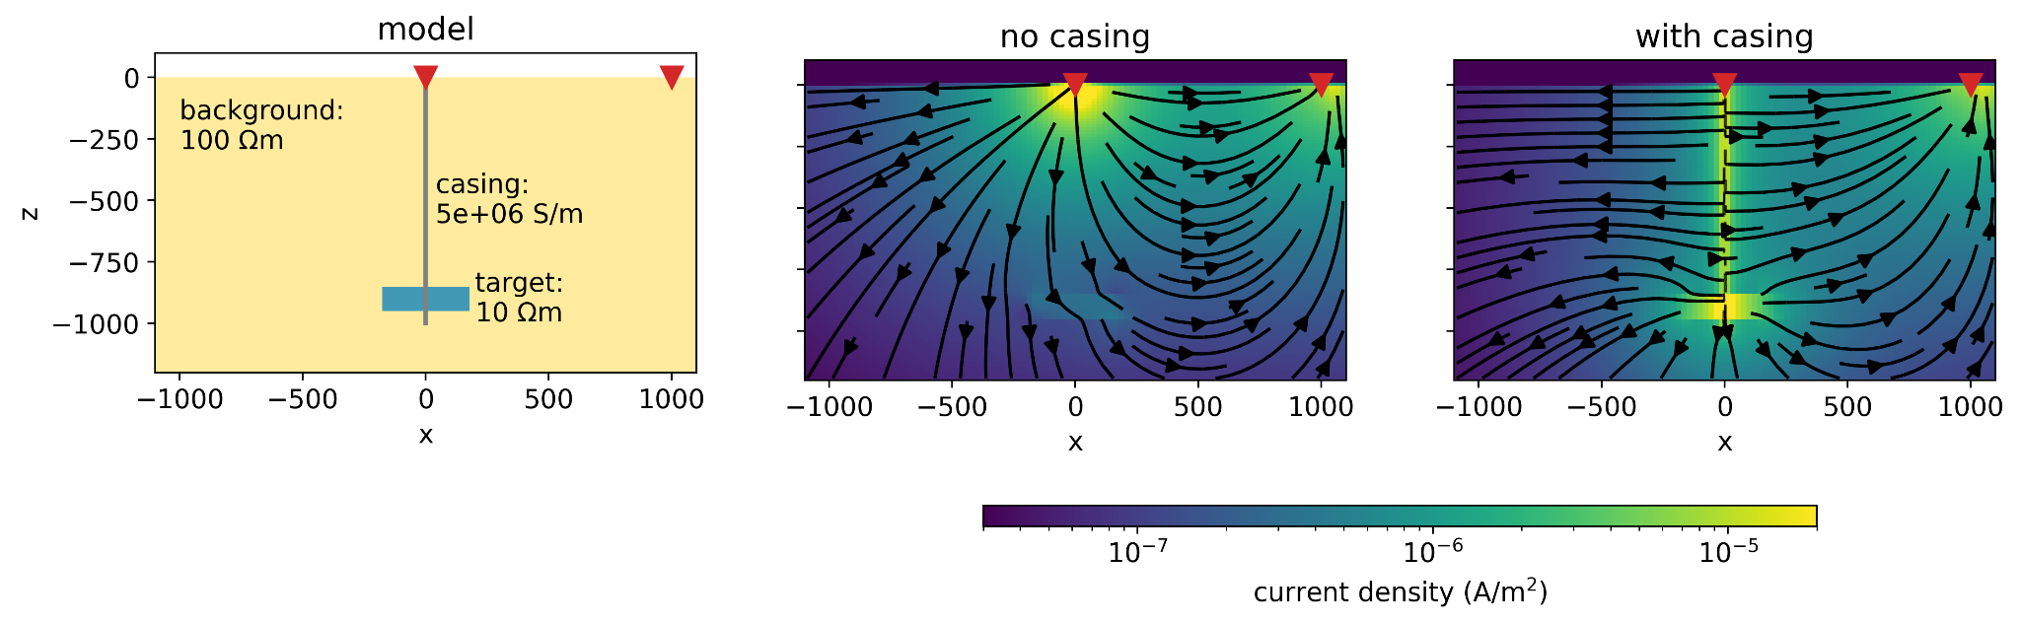
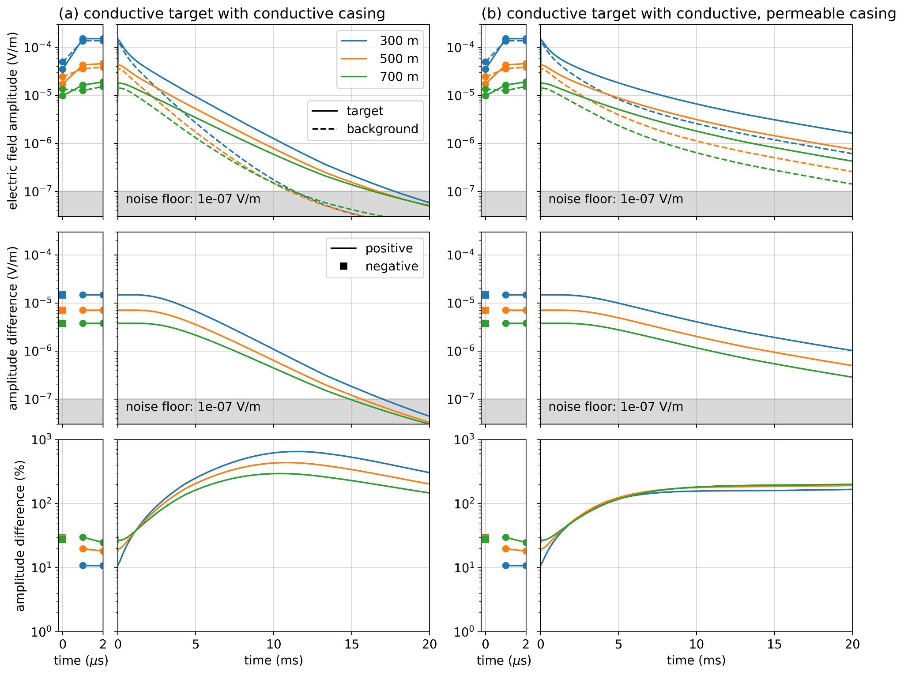
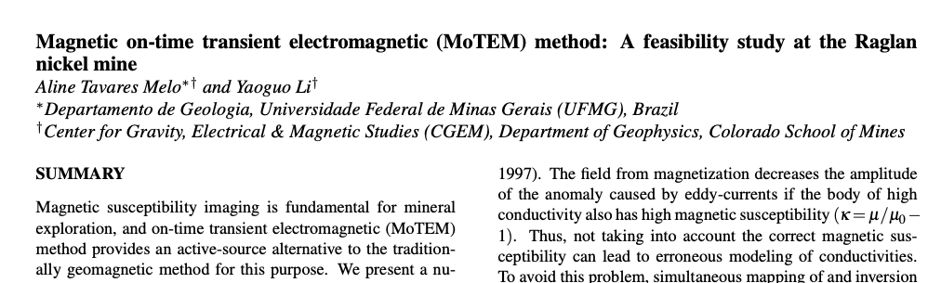
electromagnetics
impacts of permeability in EM
highly conductive targets
upscaling & physical properties
(Melo & Li, 2020)
(Heagy & Oldenburg, 2021)

Slide 9
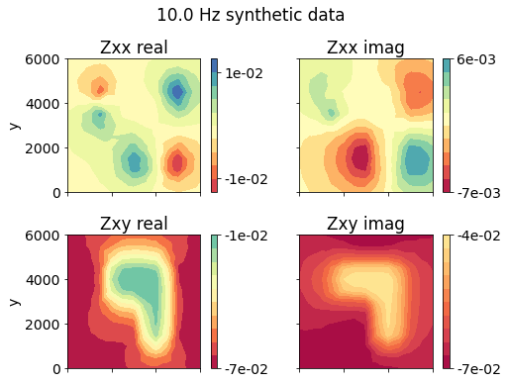

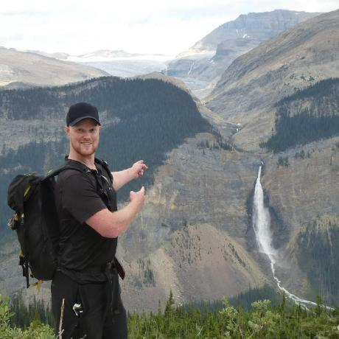
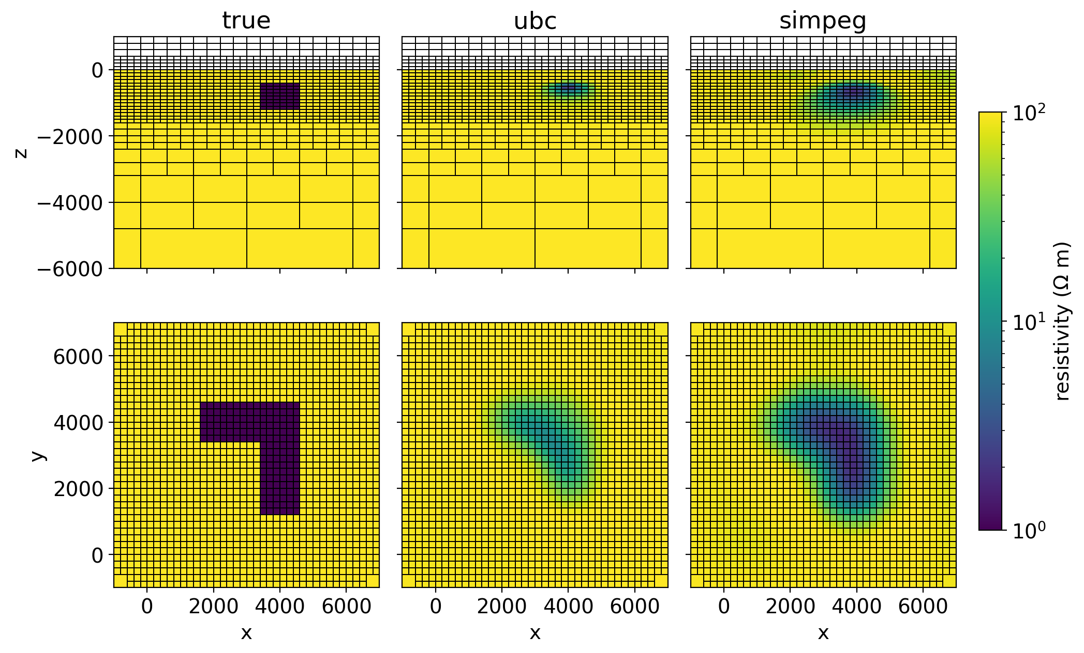
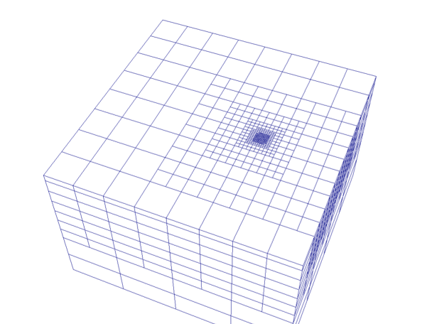
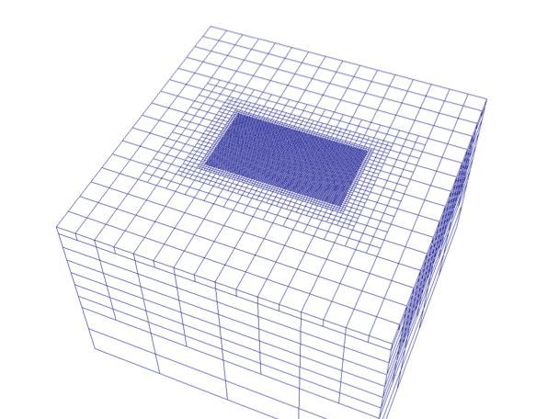


electromagnetics
large scale
remanent magnetization
natural source EM
sparse, compact norms
J. Kuttai
D. Cowan
D. Fournier
J. Capriotti
Notes:
work on more advanced inversions– sparse / compact norms, primarily in potential fields, EM more non-linear

Slide 10
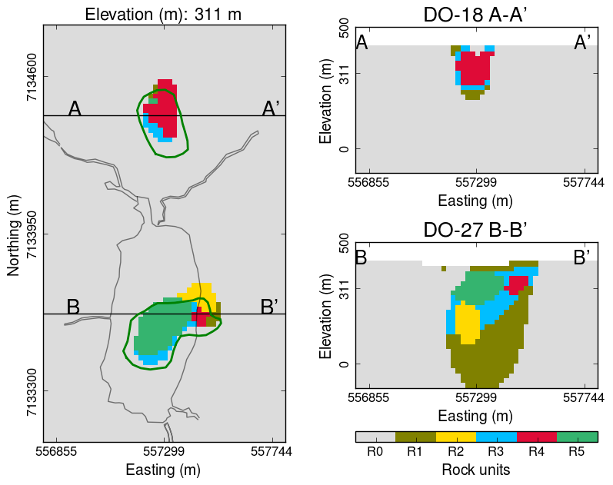
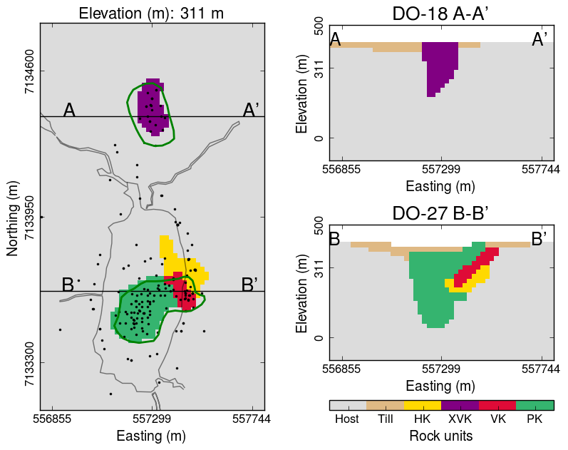
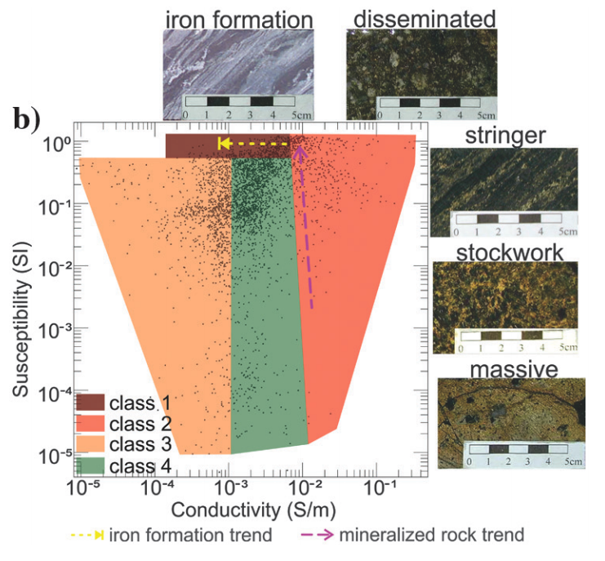
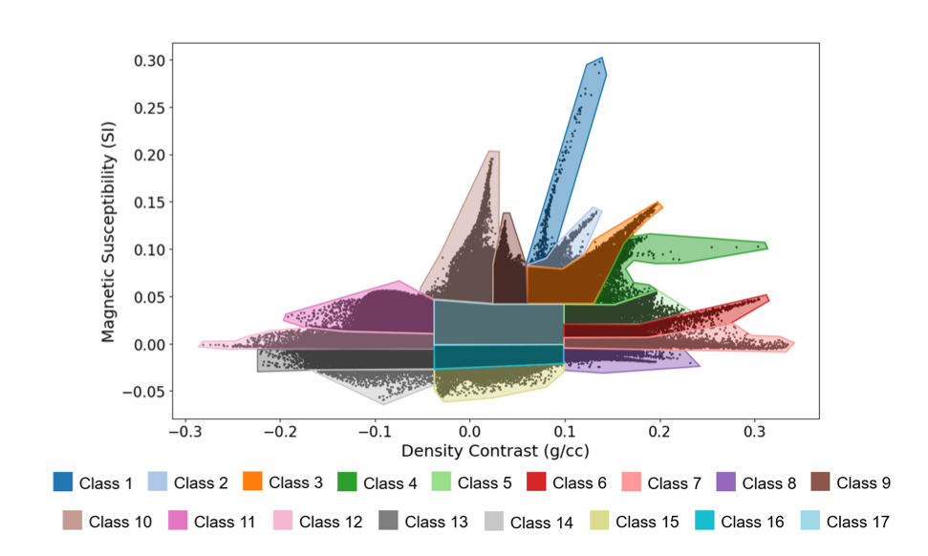
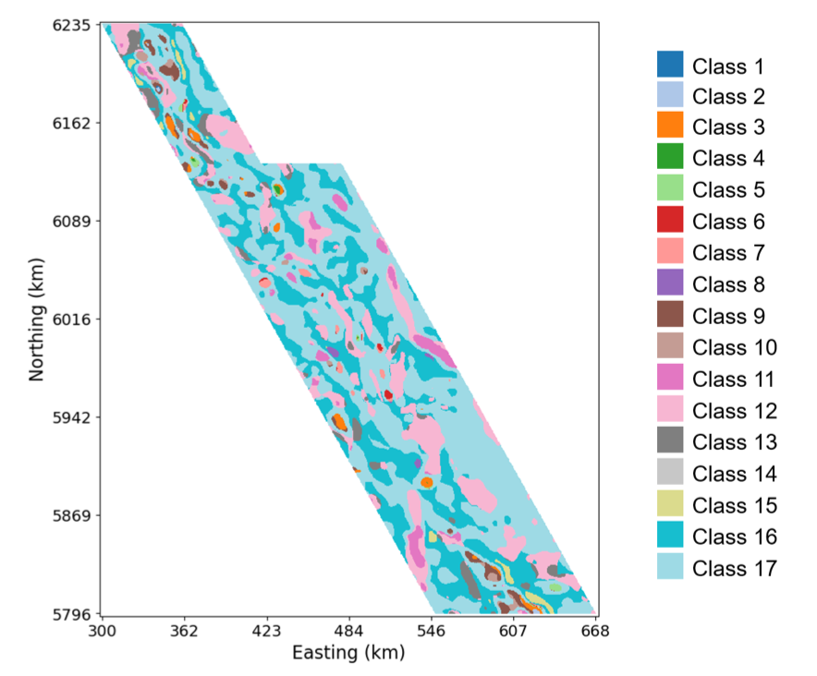
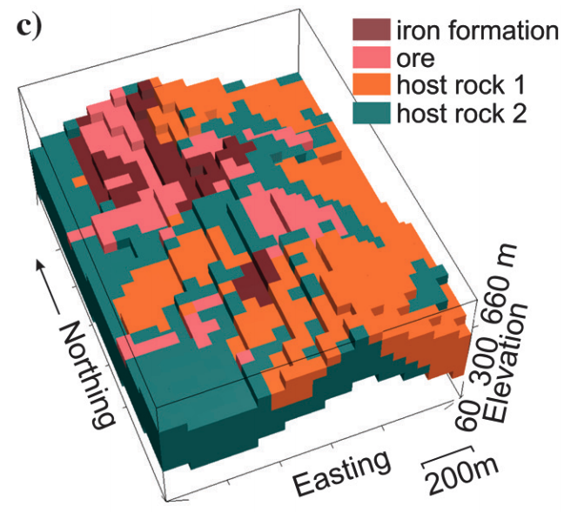
integrating geology, physical properties, geophysics
post-inversion classification
opportunities with machine learning
From geophysics
From drilling
From geophysics
From drilling
Melo et al., 2017
Kim et al., 2020
Devriese et al, 2017; Fournier et al, 2017; Kang et al, 2017

Slide 11
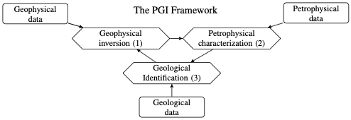
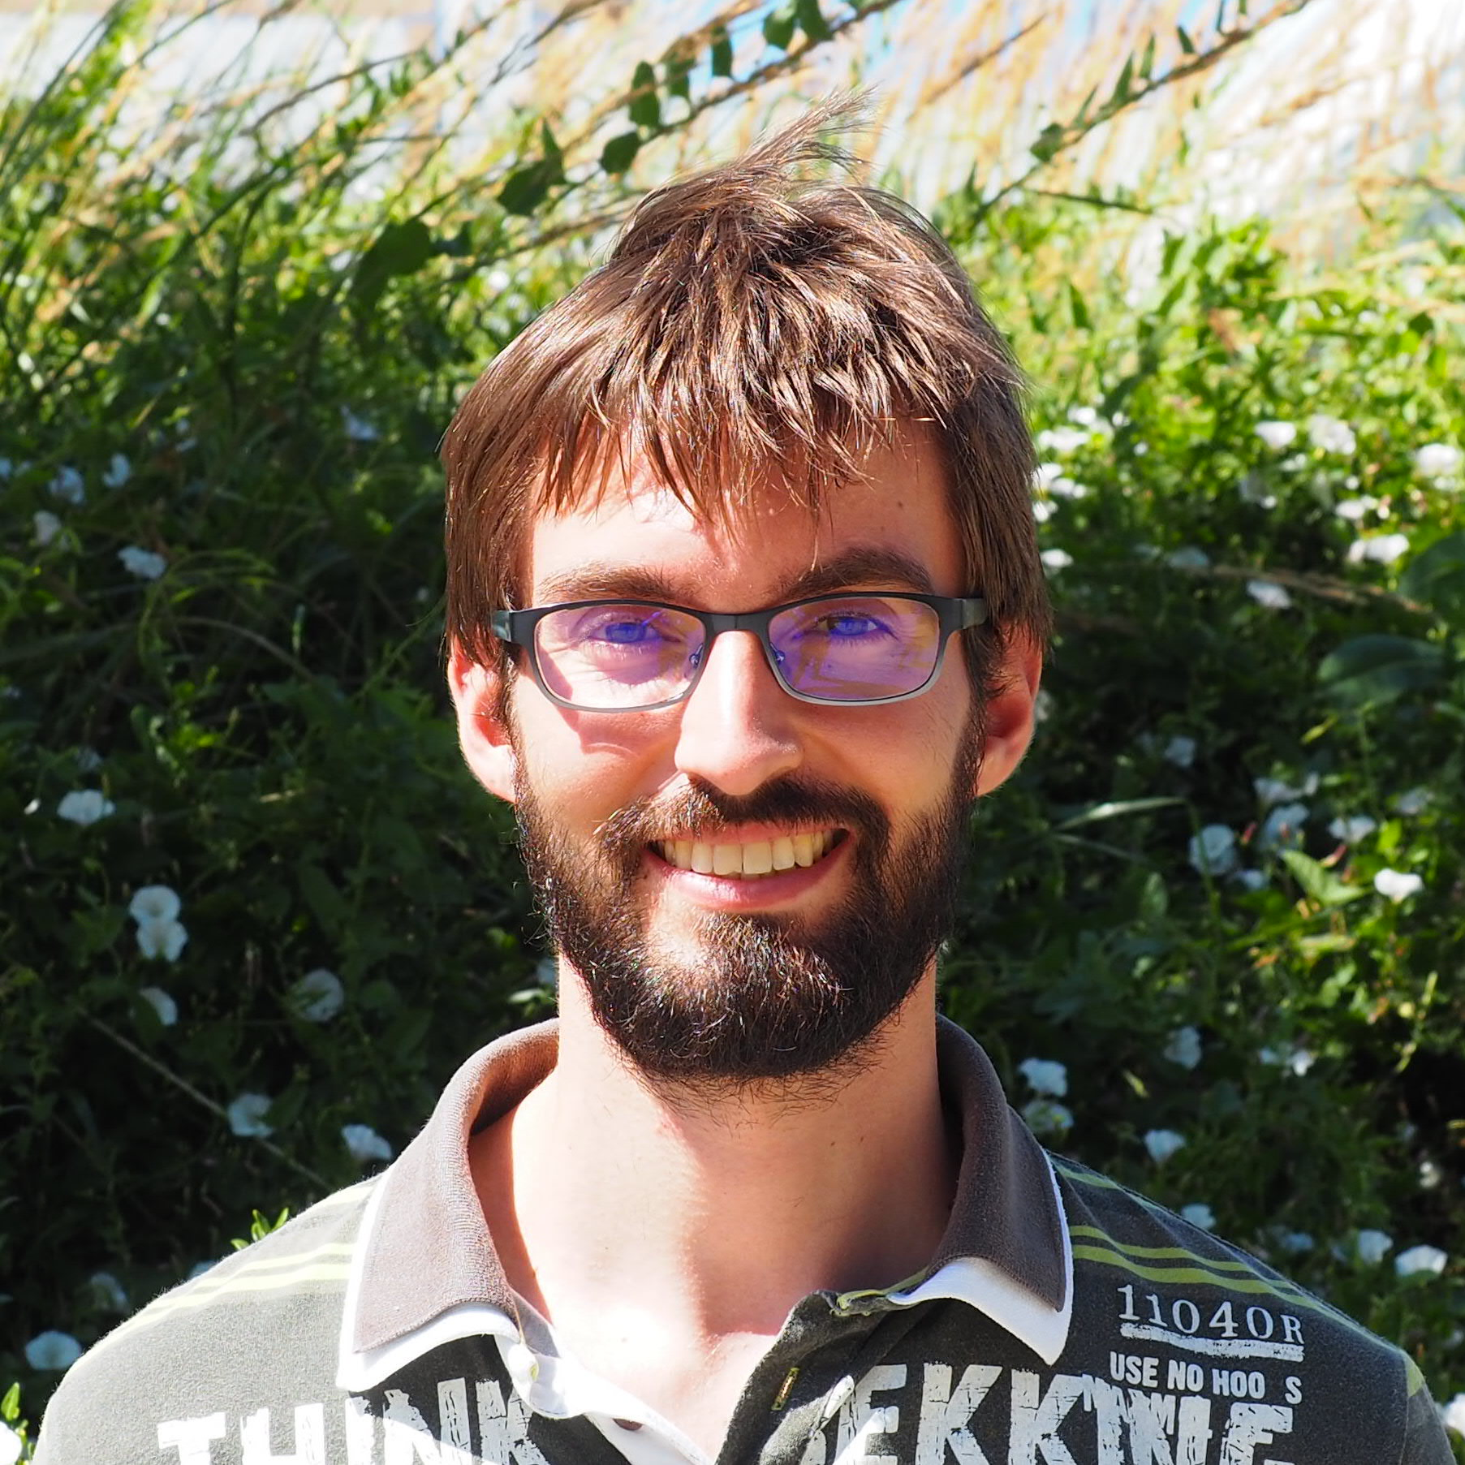
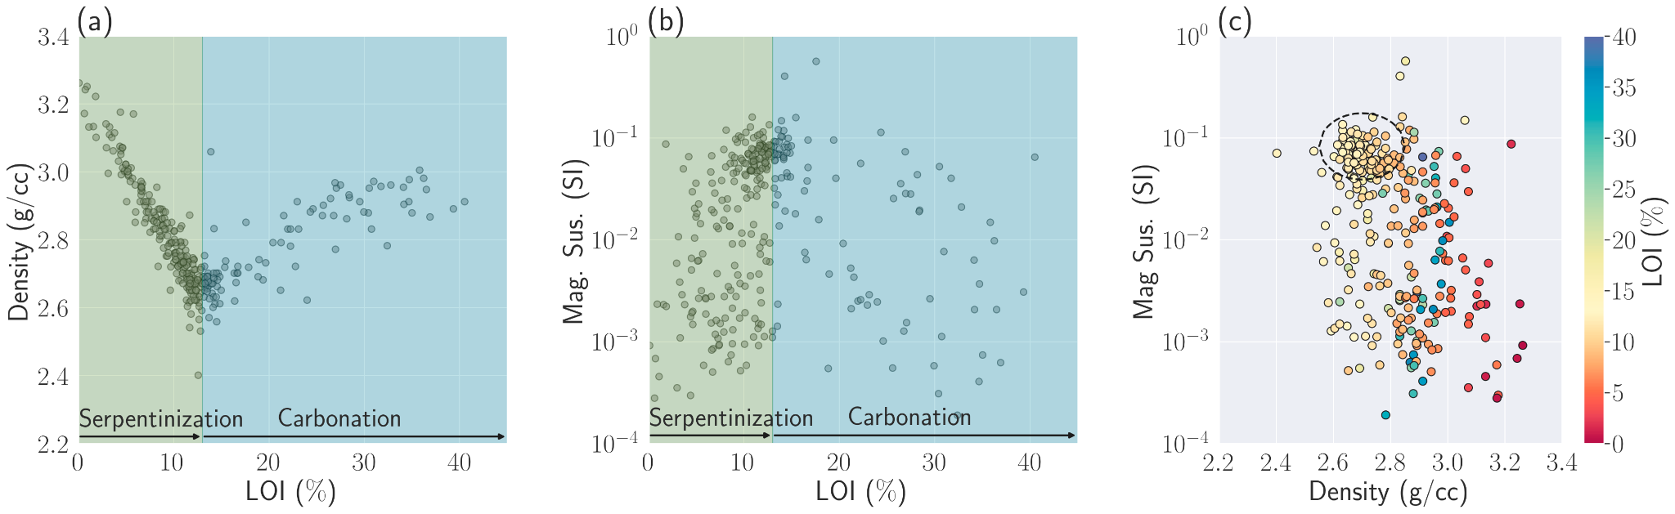
integrating geology, physical properties, geophysics
including physical property & geologic information in inversions
Petrophysically and Geologically Guided Inversion (PGI)
T. Astic

Slide 12
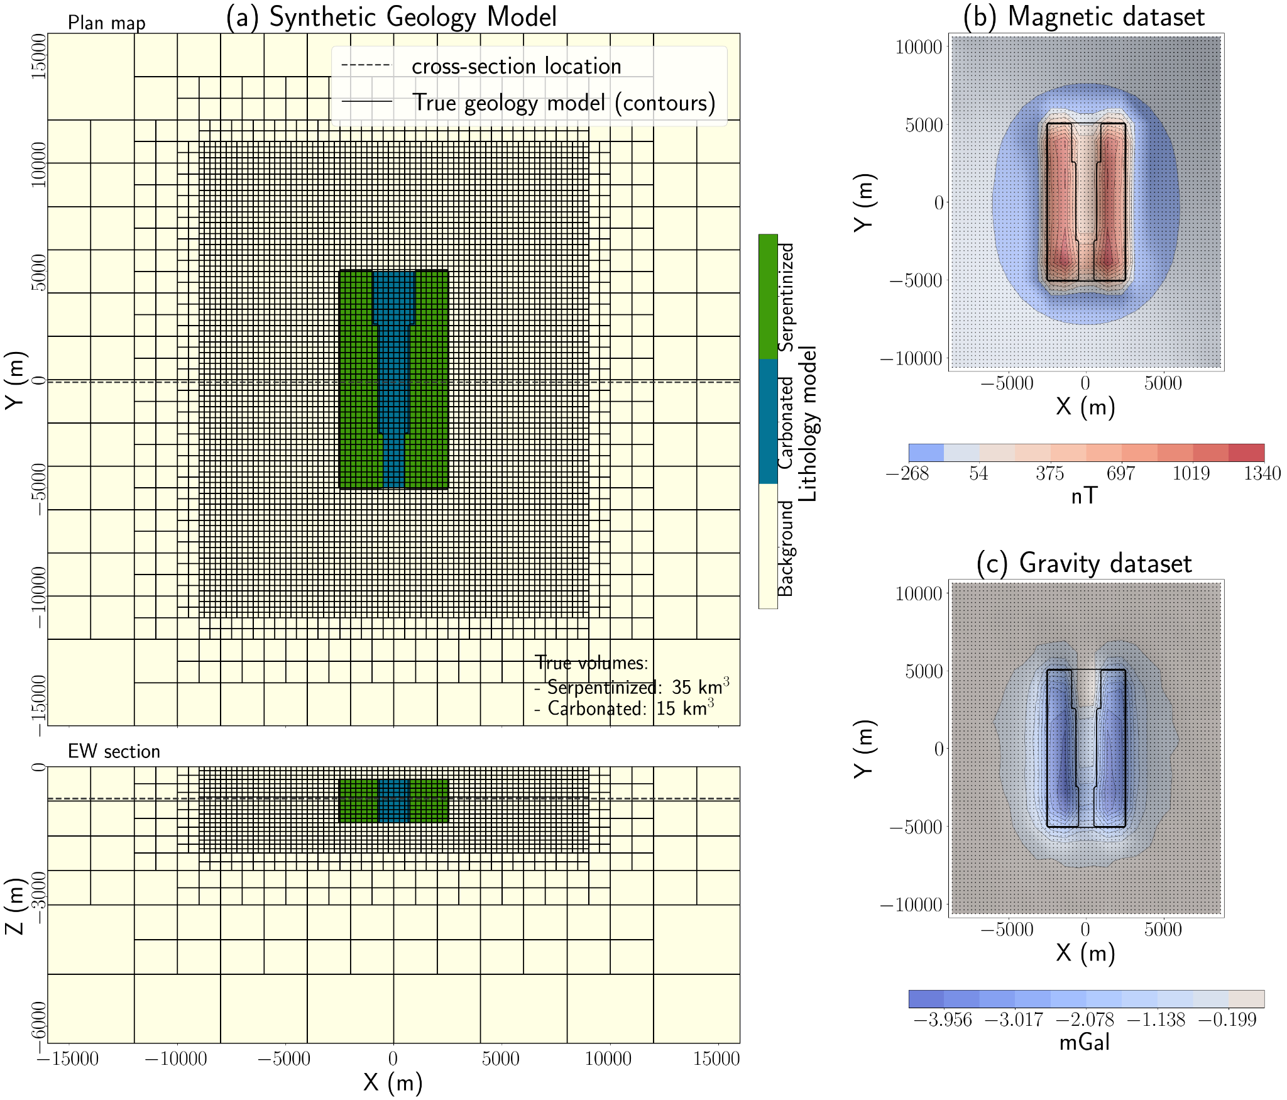
an example: carbon mineralization
example motivated by Decar, BC
goals: delineate, estimate volumes
future goal: alteration information?
 | mag susc (SI) | density (g/cc) | dens contrast (g/cc)
background | 0 | 2.9 | 0.0
serpentinized | 0.15 | 2.7 | -0.2
carbonated | 0.05 | 3.0 | 0.1

Slide 13
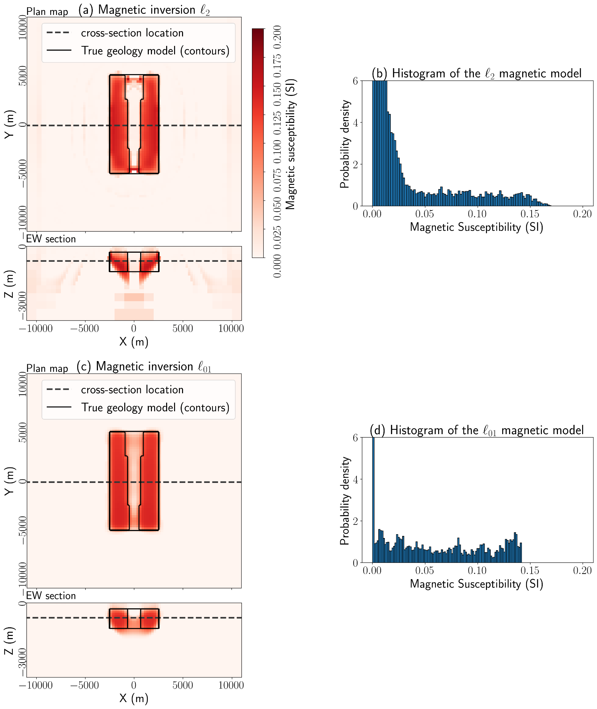
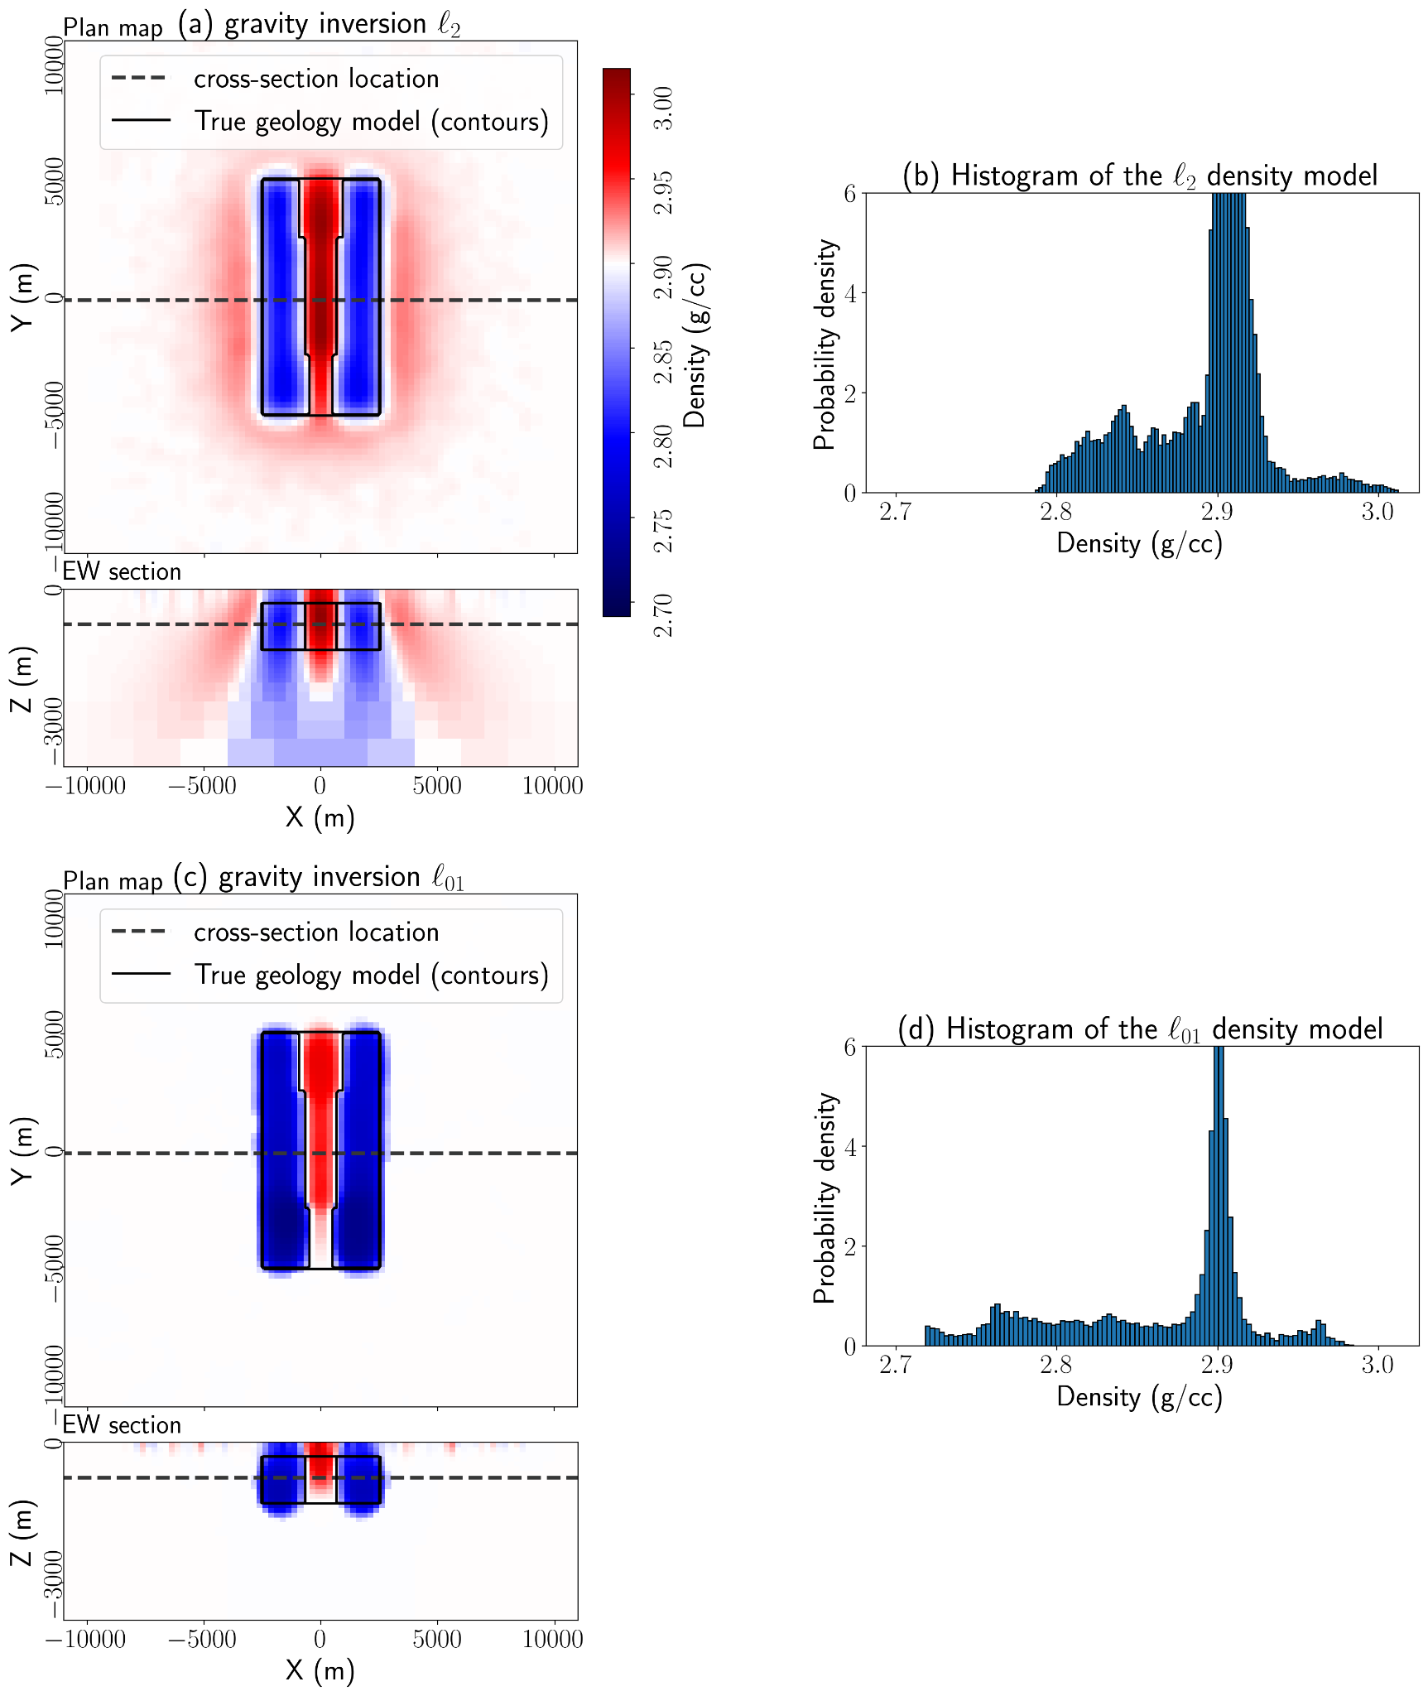

an example: carbon mineralization
serpentinized
serpentinized
carbonated
carbonated

Slide 14
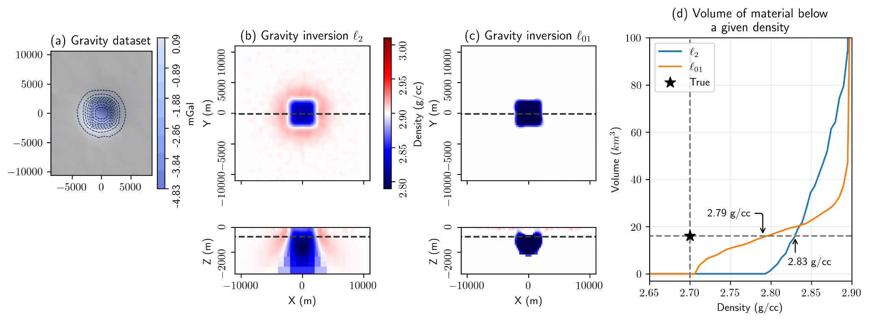
how do we choose a threshold?
using: identical mesh, survey, inversion parameters, perform simulations and inversions with a representative block.

Slide 15
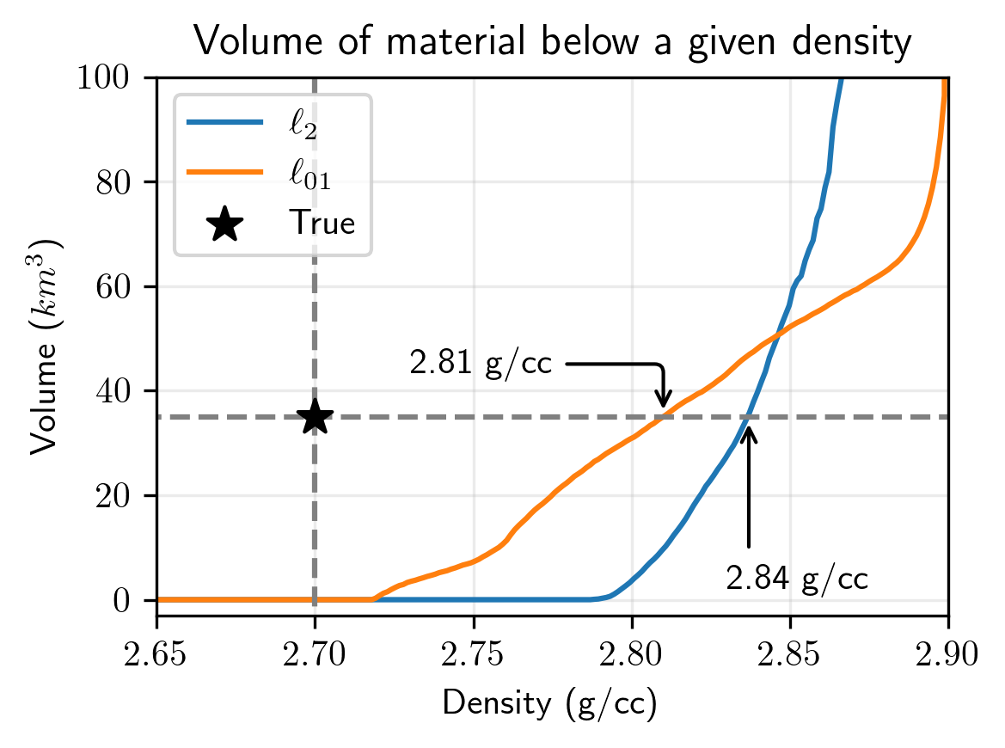
how do we choose a threshold?
serpentinized
carbonated
Threshold from proxy: 2.83, 2.79 g/cc
: 27 km³
: 27 km³

Slide 16
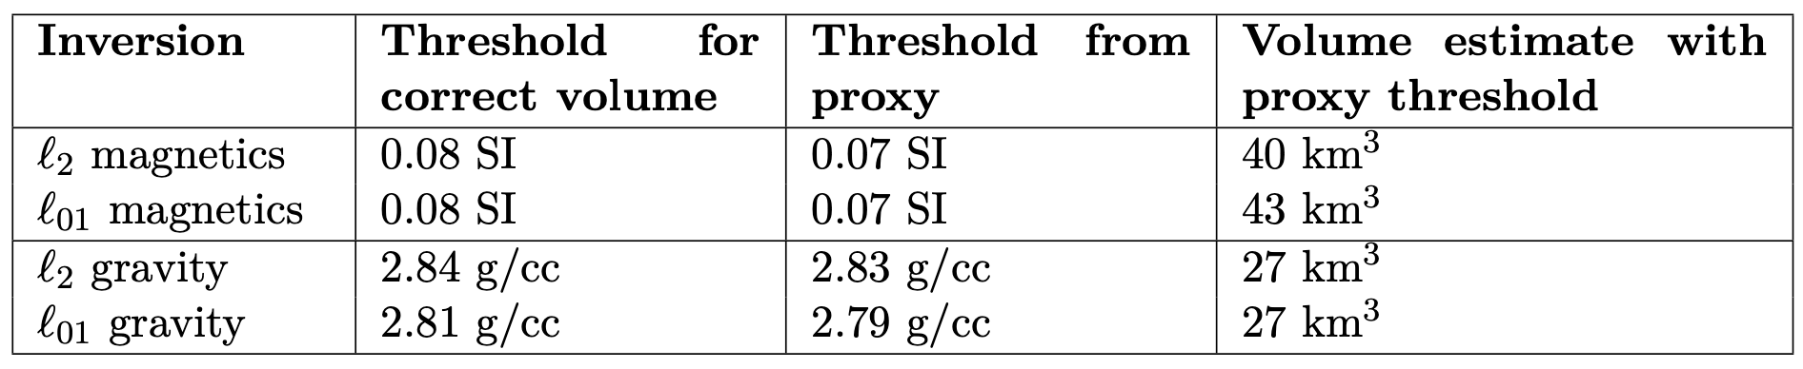
how do we choose a threshold?
proxy model → tool for estimating an appropriate physical property threshold
Also of interest:
delineating the top → ex-situ vs. in-situ
joint inversion → consistent model?
susceptibility
density

Slide 17
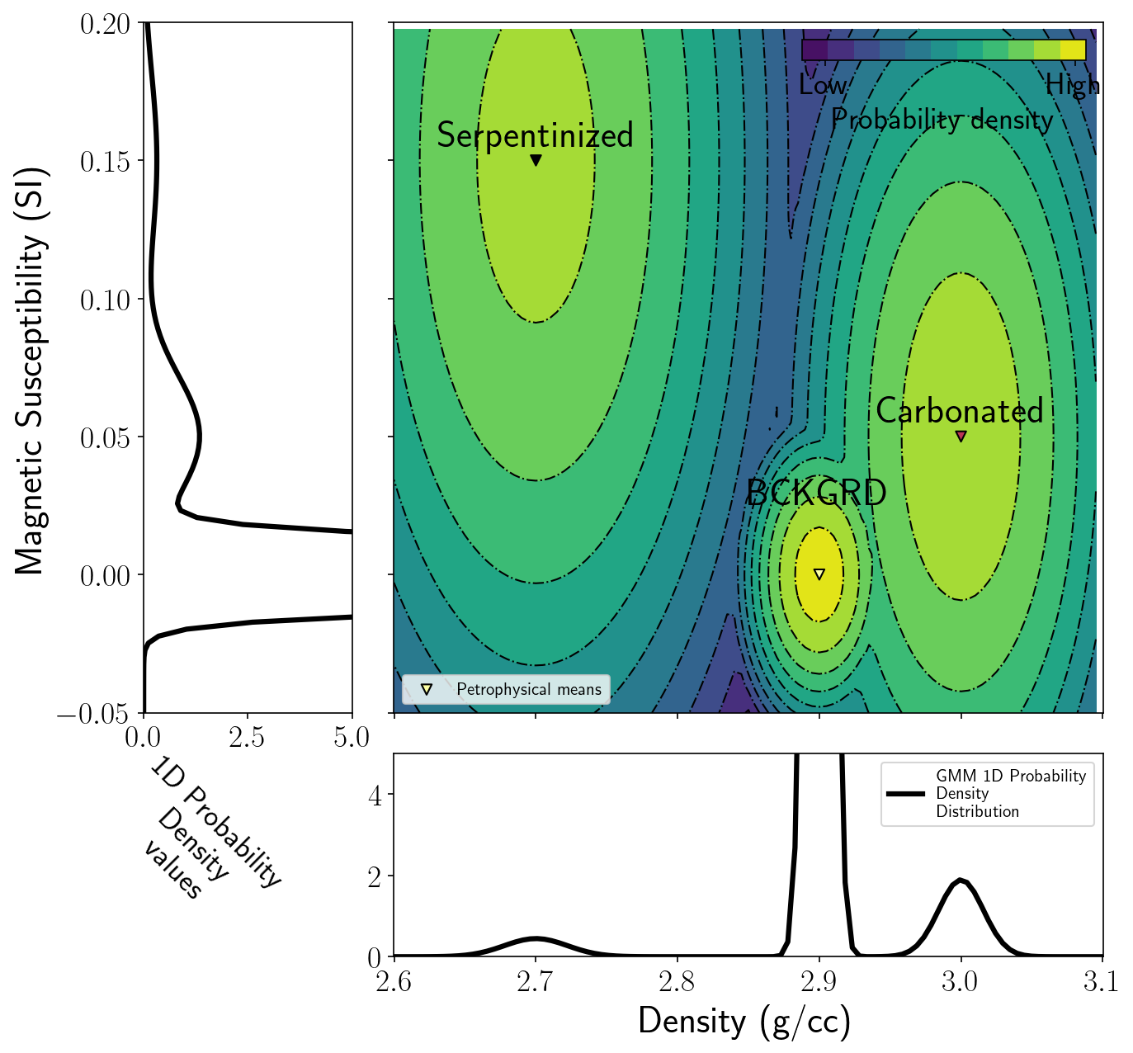
Petrophysically and Geologically Guided Inversion
Gaussian mixture model (GMM)
Alternative approach to the inverse problem
brings in petrophysical information (GMM)
builds a quasi-geology model

Slide 18
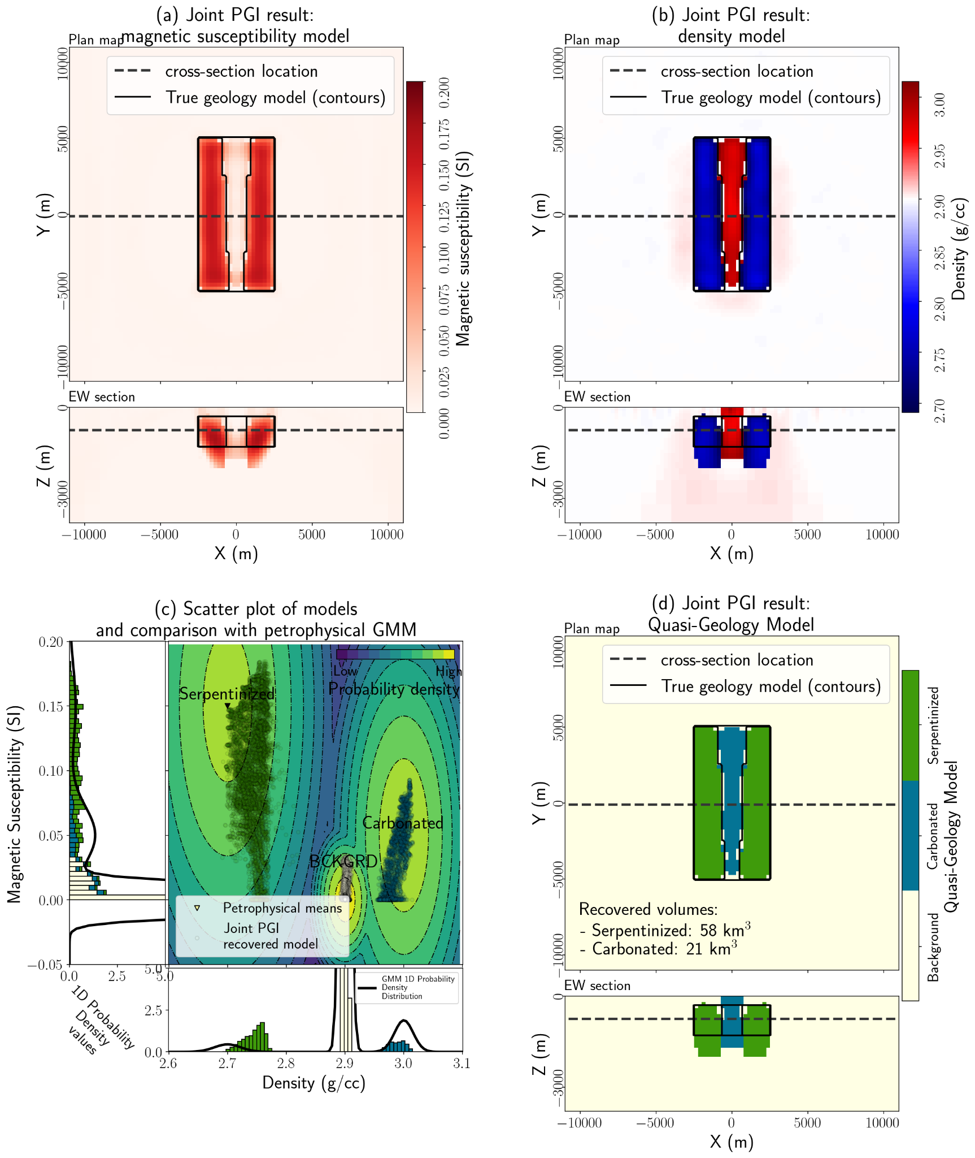
Joint PGI
Inversion fits both geophysical data sets and petrophysical data
Weighting strategies to balance contributions (Astic et al, 2021)
One quasi geology model consistent with both data sets
Good estimate to top of serpentinized rock volume

Slide 19
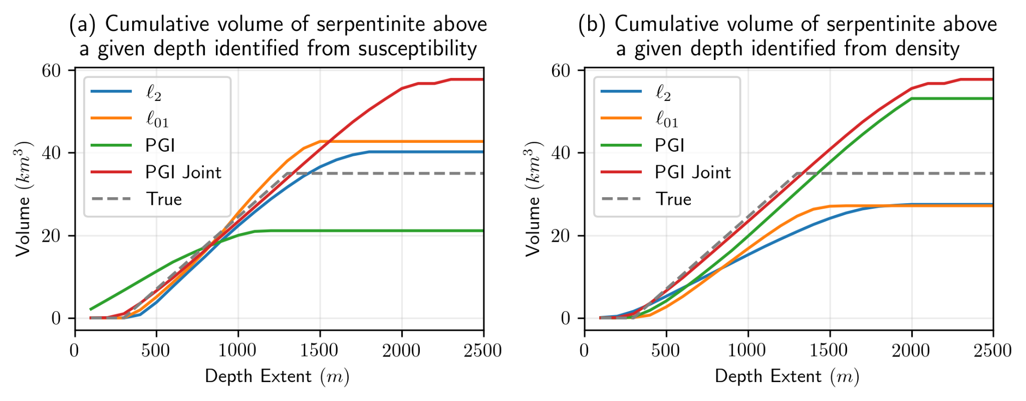
cumulative volume estimates with depth
Total volume of interest for CO₂ sequestration capacity
Depth of practical importance for in-situ vs. ex-situ

Slide 20
a sampling of research avenues
questions in electromagnetics
strong conductors
magnetic permeability
natural source EM
large scale
integrating geology, physical properties, and geophysics & joint inversions
post inversion classification
PGI
non-linear inversions (EM)
role of machine learning
critical minerals
geologic storage of CO₂
geotechnical (e.g. permafrost)
groundwater

Slide 21
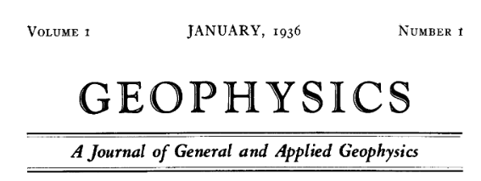
geophysics in a changing climate
Volume 20 | Issue 4 | October 1955
Magnetic delay line filtering techniques
Jones, Morrison, Sarrafian, Spieker
An amplitude study on a seismic model
Clay and McNeil
Velocity anisotropy in stratified media
Uhrig and Van Melle
Wave propagation in a stratified medium
Postma
Minimum variance in gravity analysis Part 1: One-Dimensional
Brown
Gravity investigations in the Hockley Salt Dome, Harris County, Texas
Allen, Caillouet, Stanley
Simultaneous gamma ray and resistance logging as applied to uranium exploration
Broding and Rummerfield
A low frequency electrical earth model
Pritchett
Line spacing effect and determination of optimum spacing illustrated by Marmora, Ontario magnetic anomaly
Agocs
Some applications of geophysical prospecting in the union of South Africa
Enslin
The application of a three-element model to the S.P. and resistivity phenomena evinced by dirty sands
McKelvey, Southwick, Spiegler, Wyllie
Discussions and communications: Propagation of transient electromagnetic waves in a conducting medium

Slide 22
geophysics in a changing climate
Volume 20 | Issue 4 | October 1955
Magnetic delay line filtering techniques
Jones, Morrison, Sarrafian, Spieker
An amplitude study on a seismic model
Clay and McNeil
Velocity anisotropy in stratified media
Uhrig and Van Melle
Wave propagation in a stratified medium
Postma
Minimum variance in gravity analysis Part 1: One-Dimensional
Brown
Gravity investigations in the Hockley Salt Dome, Harris County, Texas
Allen, Caillouet, Stanley
Simultaneous gamma ray and resistance logging as applied to uranium exploration
Broding and Rummerfield
A low frequency electrical earth model
Pritchett
Line spacing effect and determination of optimum spacing illustrated by Marmora, Ontario magnetic anomaly
Agocs
Some applications of geophysical prospecting in the union of South Africa
Enslin
The application of a three-element model to the S.P. and resistivity phenomena evinced by dirty sands
McKelvey, Southwick, Spiegler, Wyllie
Discussions and communications: Propagation of transient electromagnetic waves in a conducting medium

Slide 23
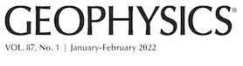

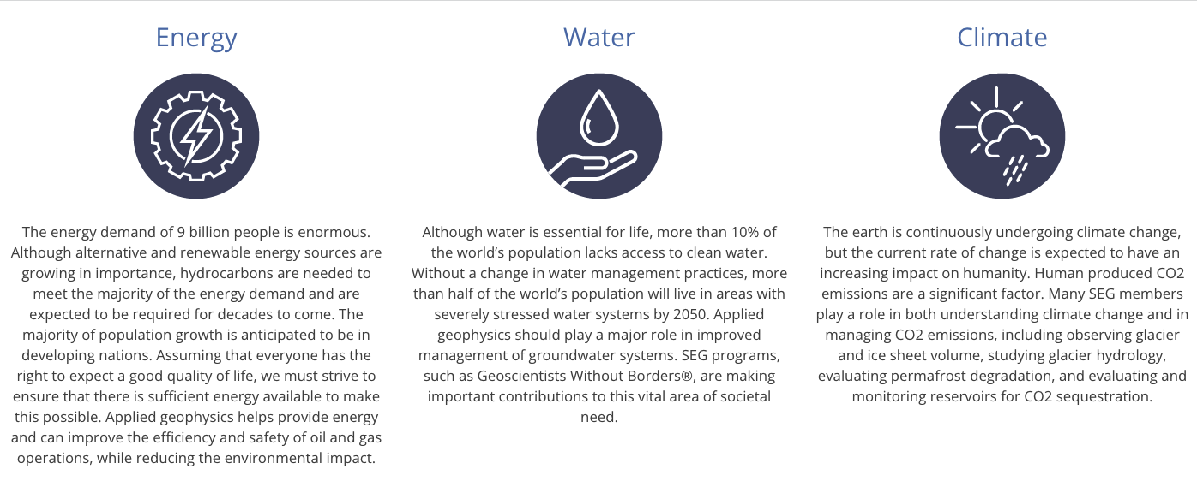
geophysics in a changing climate
https://seg.org/WhatGeophysicistsDo
Notes:
where is mining?
where is the vision?

Slide 24
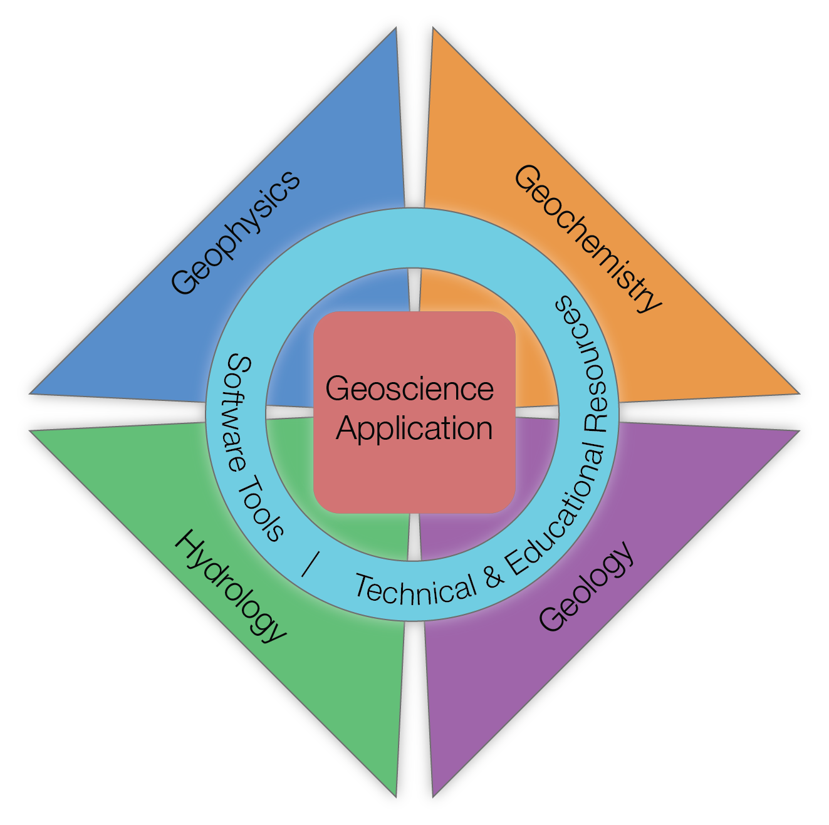
geophysics in a changing climate
where does geophysics fit in interdisciplinary problems?
who is involved?
what is the brand of applied geophysics?

Slide 25








interdisciplinary questions
Technical: machine learning + inversion for combining data
Collaboration: between disciplines
Role of open science, educational resources

Slide 26
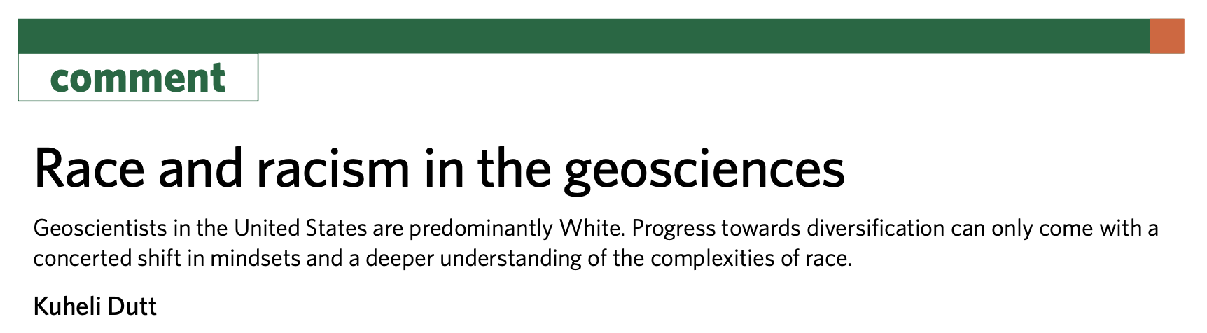

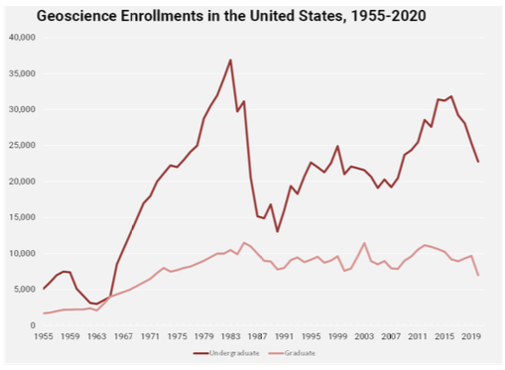

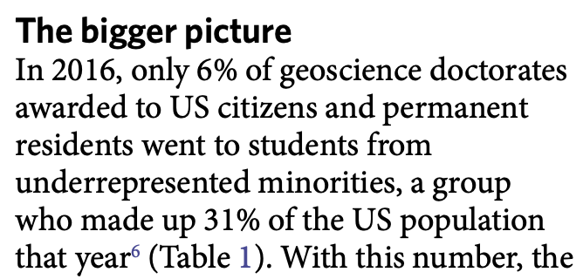
who is involved?
Undergrad⬇10%
Grad⬇27%
Notes:
geoscience: lowest proportion of all STEM fields

Slide 27



ways forward?
rebranding “applied geophysics”
connecting with values
proactive on climate change solutions
including emphasis on technology, computation
role of societies
maintain / promote brand of applied geophysics
engage students
BCGS, KEGS scholarships / internships
amplifying positive initiatives
…?

Slide 28




thank you!
lheagy@eoas.ubc.ca
@lheagy
@lindsey_jh

Slide 30
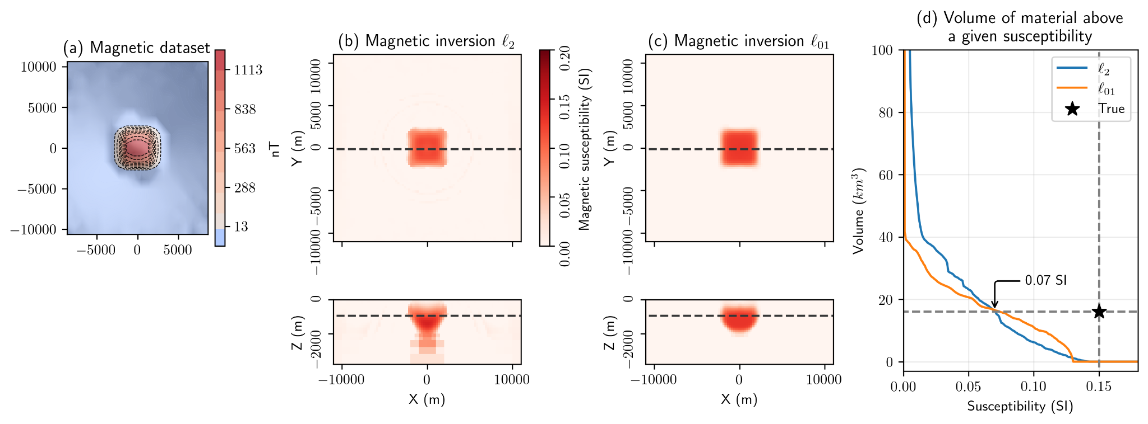
Magnetics: proxy model
using: identical mesh, survey, inversion parameters, perform simulations and inversions with a representative block.

Slide 31
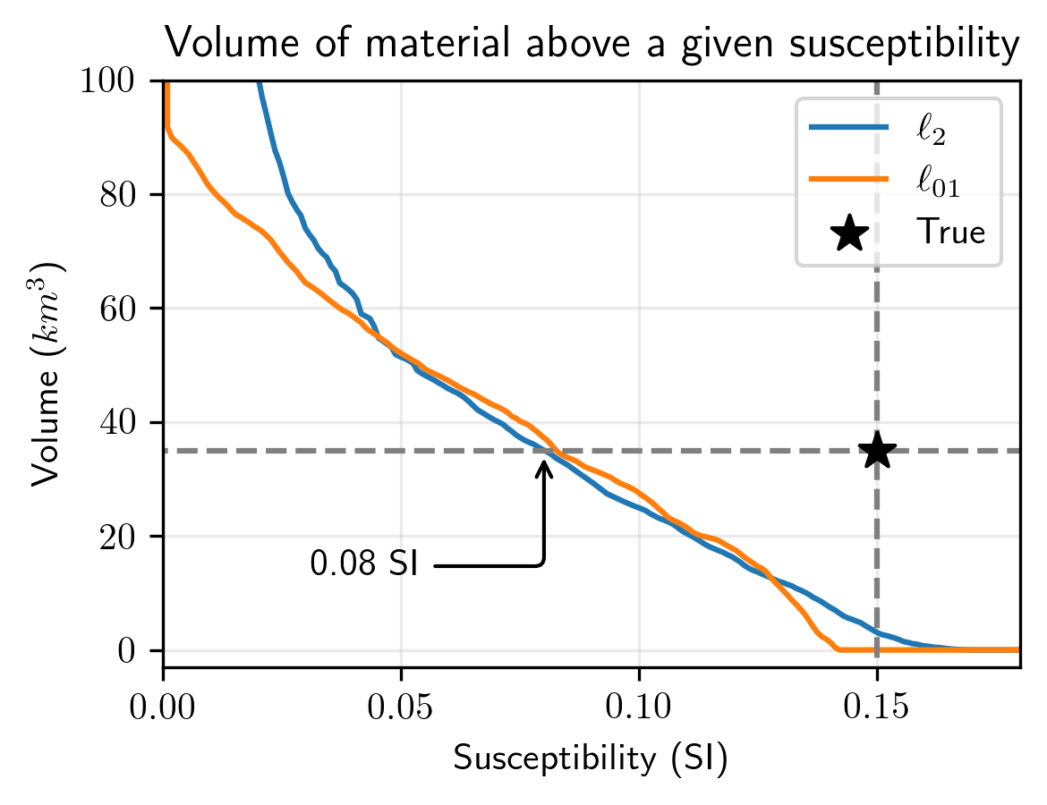
Magnetics
Use threshold from proxy: 0.07 SI
: 40 km³
: 43 km³

